Slide 1
BU METCS 673
Team 3 Project: MyMedic
Iteration 3
John Gutierrez, Indra Sigicharla, Adriel Domingo, Mengliang Tan, Uzay Isin Alici, Tyler Gonsalves, Hongcheng Ding

Slide 2
Roles
Lead - Indra Sigicharla and John Gutierrez
Requirements Lead - Adriel Domingo and John Gutierrez
Design and Implementation Lead - John Gutierrez, Tyler Gonsalves, and Hongcheng Ding
QA Lead - Mengliang Tan and John Gutierrez
Configuration Lead John Gutierrez, Indra Sigicharla, and Tyler Gonsalves
Security Lead - Uzay Isin Alici and John Gutierrez

Slide 3
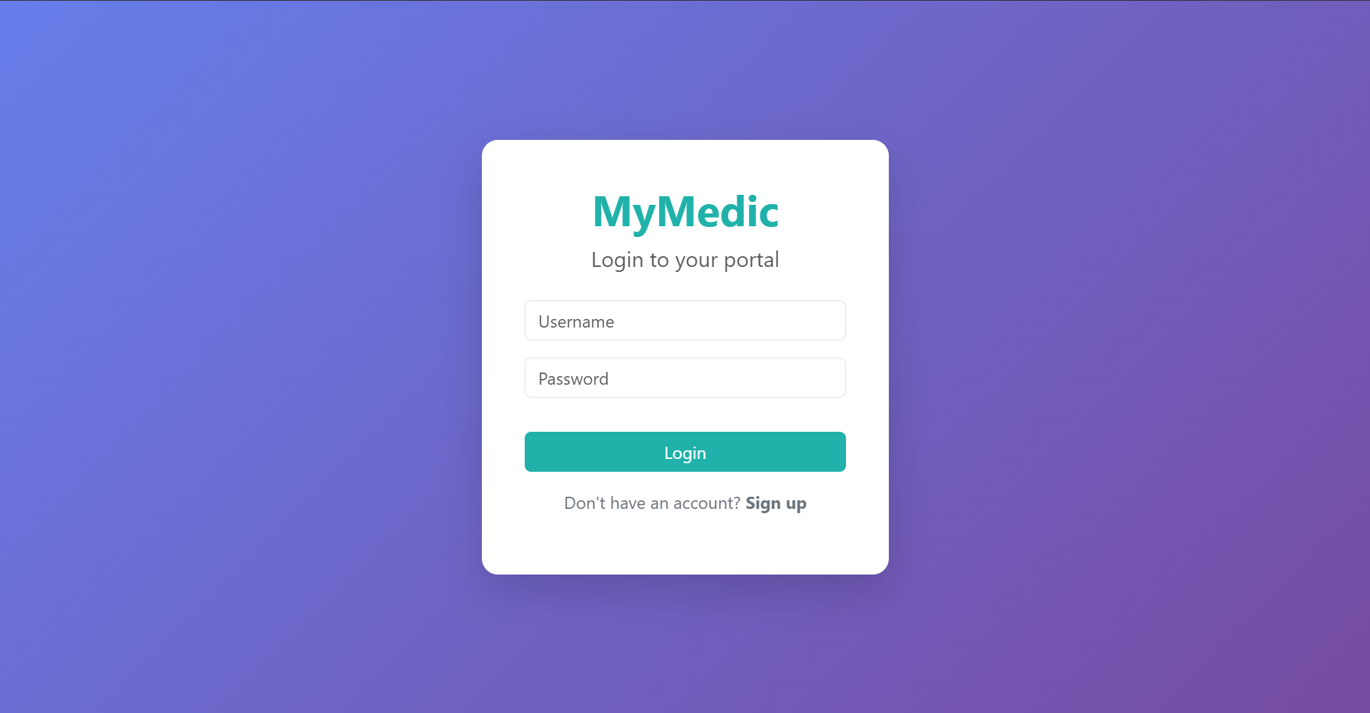
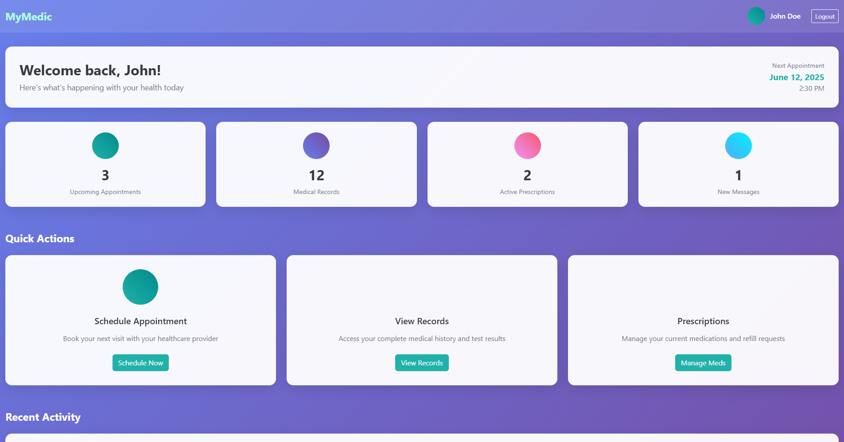
MyMedic Concept
Purpose
Personal medical system designed to empower patients by giving them secure and convenient access to their complete medical history with just one click.
Offers centralized patient-controlled health records, efficient care coordination, patient convenience.
Potential Users:
Patients - individuals managing their own or a family member’s health records.
Healthcare providers - clinics, hospitals, providers, insurance companies who need patient history.
Pharmacies - for prescription tracking.

Slide 4
Project Risks
26 Risks Identified
Personel
Communication
Requirements
Management
Technology Stack Proficiency
Design and Implementation
Testing
Integration and Deployment
Security
2 already closed
2 remain high priority
Recently mitigated risk: Jira and GitHub integration
Issue: API failure integrating Jira and GitHub
Effect: double the amount of work to manually synchronize two issue repositories
Action Taken: Migrate Jira issues to GitHub and begin using GitHub projects

Slide 5
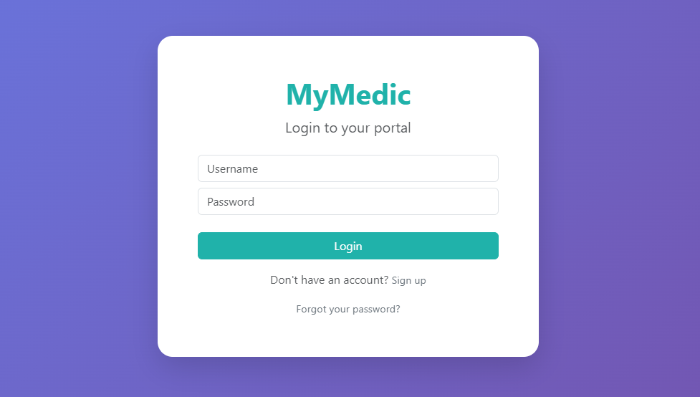
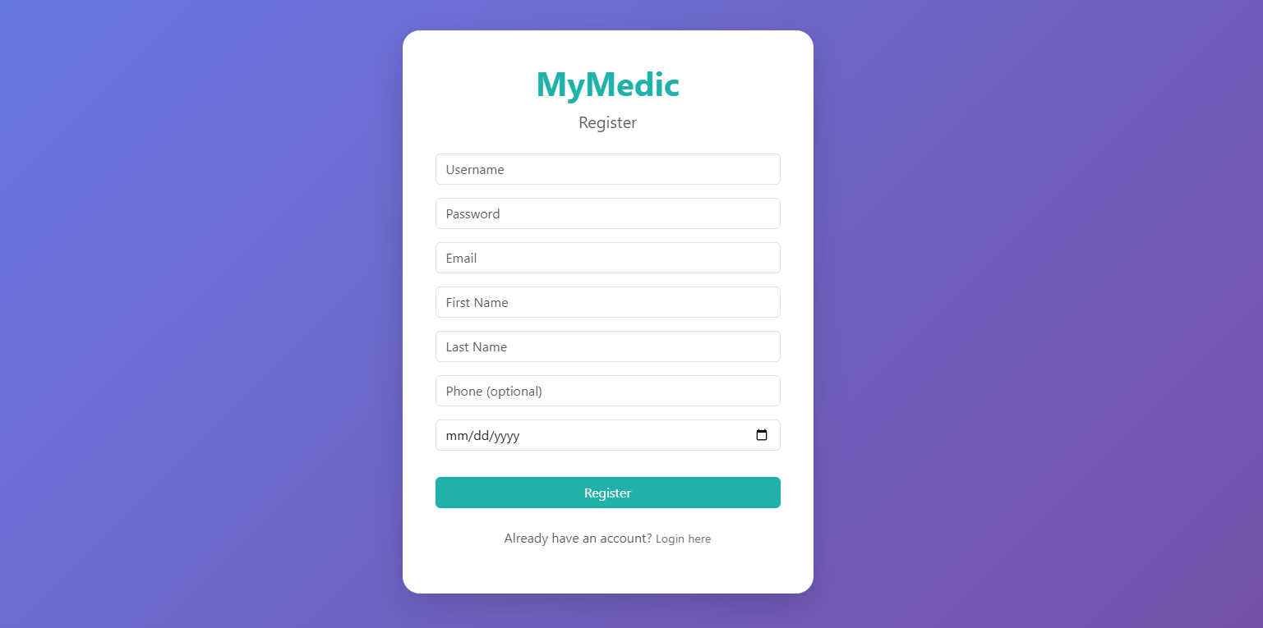
Login and Registration

Slide 6
Login and Registration
Responsive, polished UI using Bootstrap 5 and Animate.css
Clean form layout, mobile-friendly, subtle transitions for smoother UX
AJAX-powered forms (Vanilla JS) for real-time interactions
Prevents full page reloads, provides instant feedback for user actions
Login Process:
Credentials sent to /api/login/ via secure POST
On success, server generates a 6-digit code and emails it (MFA step)
User redirected to /mfa_verify/ to complete login
Registration Process:
Form captures essential fields (username, password, email, name, optional phone & DOB)
Validates input, ensures unique username/email
Creates both Django User and custom Patient profile
Sends welcome email post-registration
Security Measures:
CSRF protection for all API calls
Passwords hashed via Django’s built-in system
MFA prevents unauthorized access even with correct credentials
Clear UI messaging: Inline display of success and error states to guide the user

Slide 7
BU METCS 673
Team 3 Project: MyMedic
Iteration 3
Hongcheng Ding
Design/Implementation Lead
Topic:
requirement analysis
reset passwords feature

Slide 8
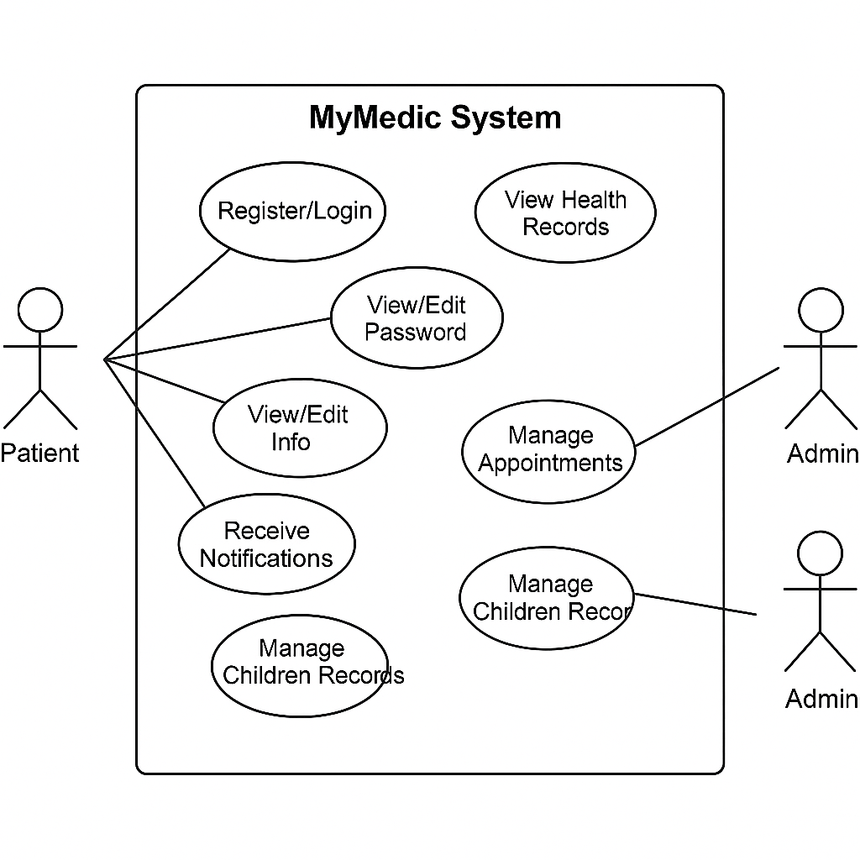
Requirement analysis
Functional Requirements:
Register / Login
View / Edit Personal Info
Reset Password
Manage Appointments (Admin)
View Health Records (Admin)
Receive Notifications
Manage Children Records
User Stories…

Slide 9
Reset Password feature
Users can securely reset passwords through email verification
User requests generate a unique, time-sensitive reset link.
Reset link sent directly to the user's registered email.
Secure form provided via link for entering a new password.
Enhances security by validating user identity through email.

Slide 10
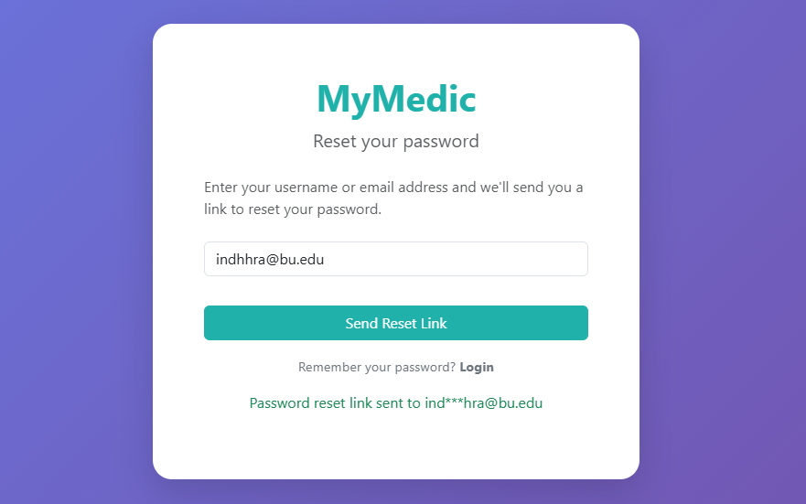
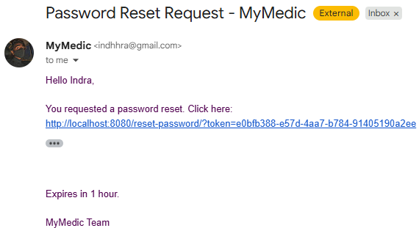
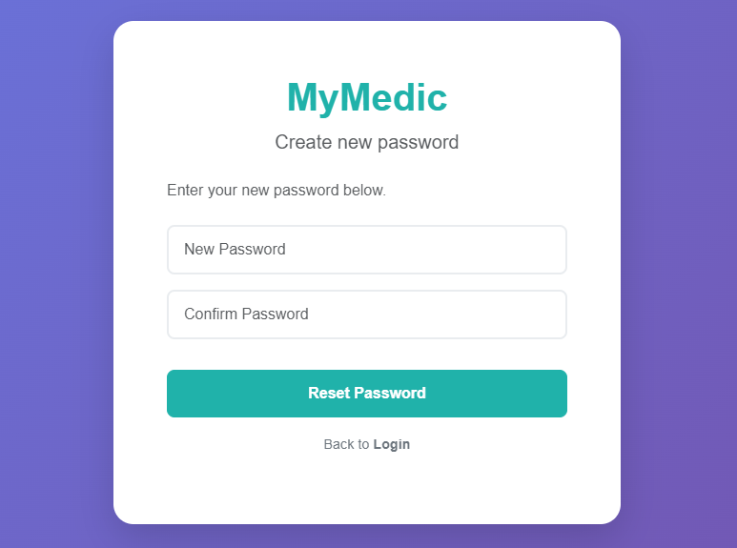
Reset Password feature

Slide 11
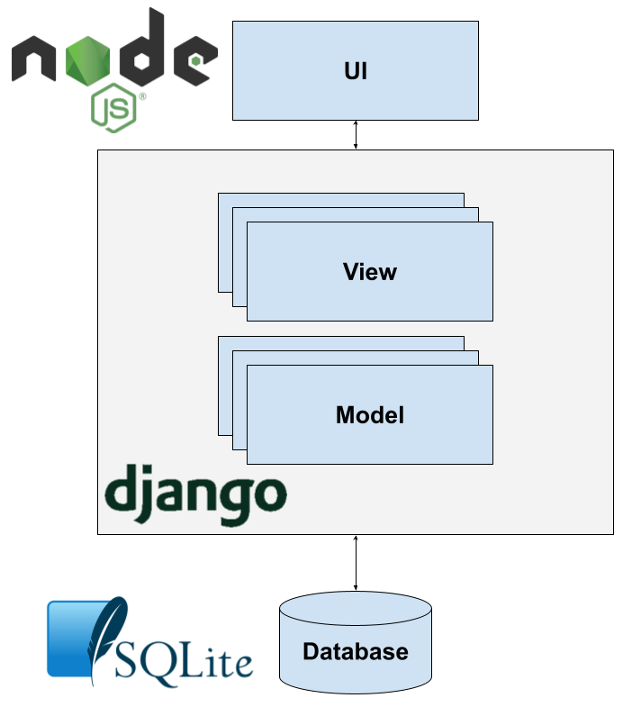
MyMedic Software Architecture

Slide 12
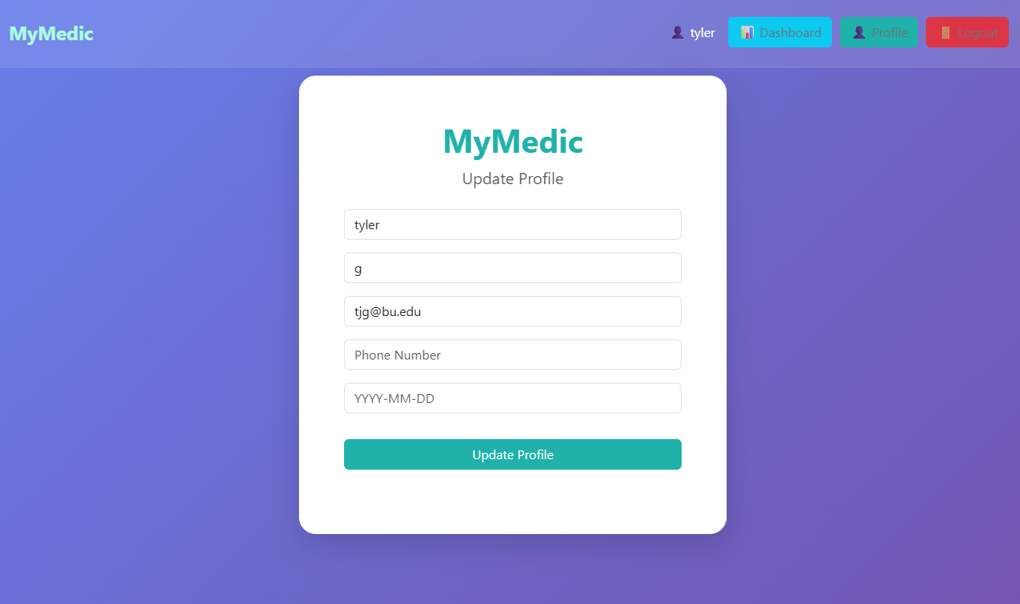
Edit Profile Feature
Profile information saved on user registration
Can click “Profile” to view and edit profile information
Testing completed to validate data is properly created and updated with PyTest

Slide 13
BU METCS 673
Project: MyMedic
Iteration 3
Iteration 3 Presentation
Uzay Isin Alici
Security Leader

Slide 14
Security
Security Goals
Ensure Confidentiality, Integrity, Availability (CIA)
Align with HIPAA requirements
HIPAA Compliance
Protecting user health data (PHI)
Audit logs & user consent
Access Control & Authentication
Role-based access (patients, doctors, admins)
Multi-factor authentication (MFA)
JWT-based login implemented using Django
REST Framework
Data Encryption
HTTPS with SSL/TLS
Encrypting sensitive data at rest and in transit (planned)
Vulnerability Assessment
Security scans planned in CI/CD phase
Incident Response
Procedure for data breaches or system attacks
Timely notification and containment steps
Backup & Recovery
Secure daily backups
Recovery plan in case of data loss
Threat Modeling (STRIDE):
Risks identified: spoofing, DoS, privilege escalation
Mitigations planned (rate limiting, RBAC)

Slide 15
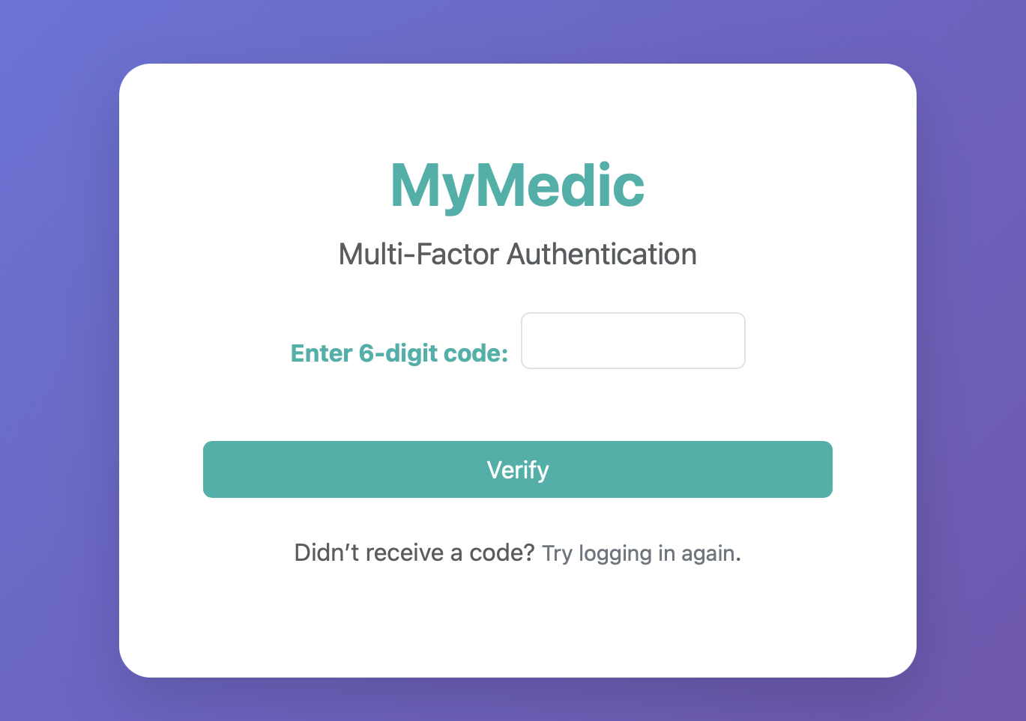
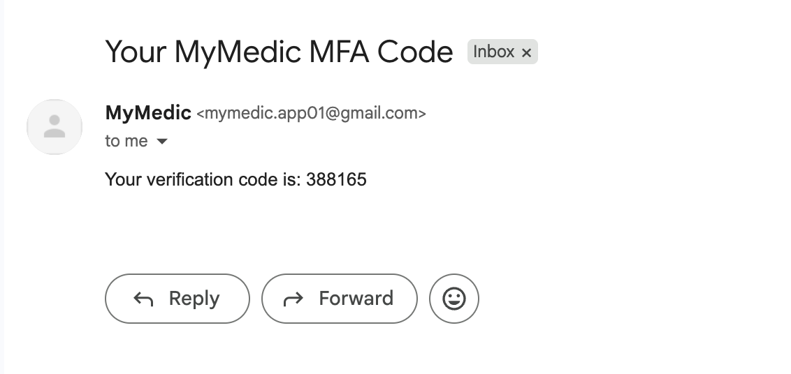
MFA
Implemented extra layer of login security using MFA.
After logging in with their username and password, The system sends a unique verification code to the user's registered email address.
The user must enter this code to access their dashboard.
Without the correct code, access is denied even if the password is correct.
This feature prevent unauthorized access and keep accounts more secure.

Slide 16
Privacy Policy
This page explains how user data is handled securely.
Because health data is involved, the design follows HIPAA rules.
Only essential information is collected (like name, contact, and medical details).
No data is shared or sold without clear user consent.
Access is limited to authorized medical staff only.
Users can review or delete their personal data anytime.

Slide 17
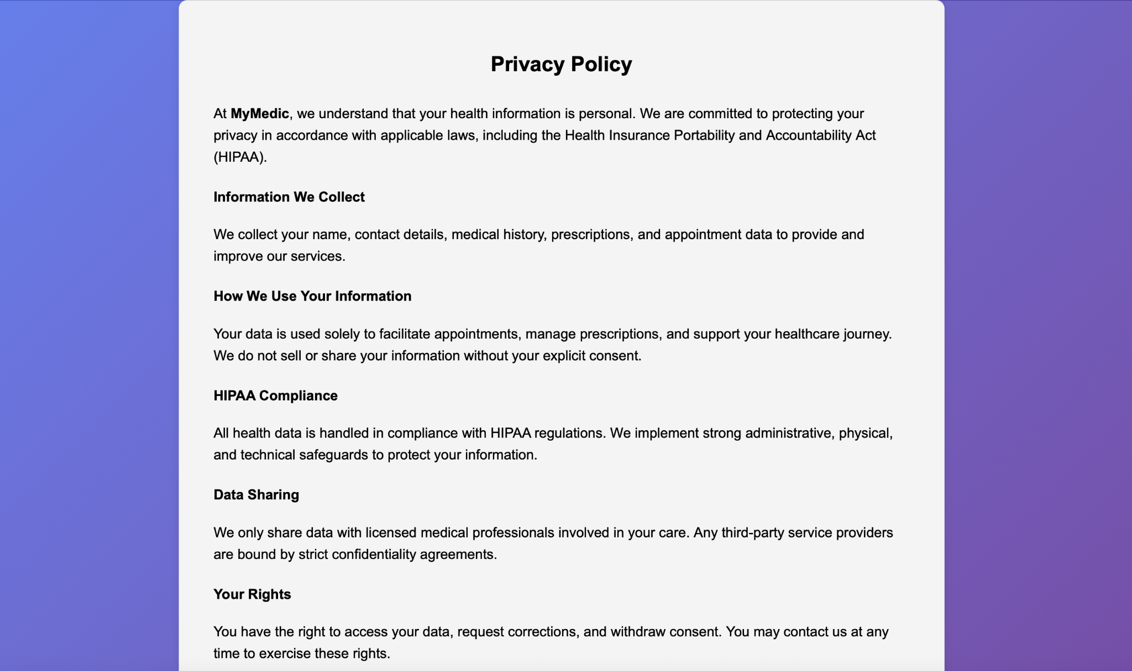

Slide 18

Cancel Appointment Feature
User Story
Description
As a patient, I want to cancel a scheduled appointment so that I can free up my time if I am unable to attend.
Acceptance Tests
Given a user has an upcoming appointment, when they click "Cancel", then they should see a confirmation popup asking them to confirm the action.
Given the user confirms the cancellation, when the page is refreshed, then the canceled appointment should no longer appear in the upcoming list.

Slide 19
Cancel Appointment Feature
This feature allows patients to cancel their upcoming appointments.
A confirmation popup prevents accidental deletions.
Once canceled, the appointment disappears from the dashboard.
Only the logged-in user can cancel their own appointments.
Appointments are added via the admin panel for testing purposes.
All cancellations are protected with CSRF security.

Slide 20
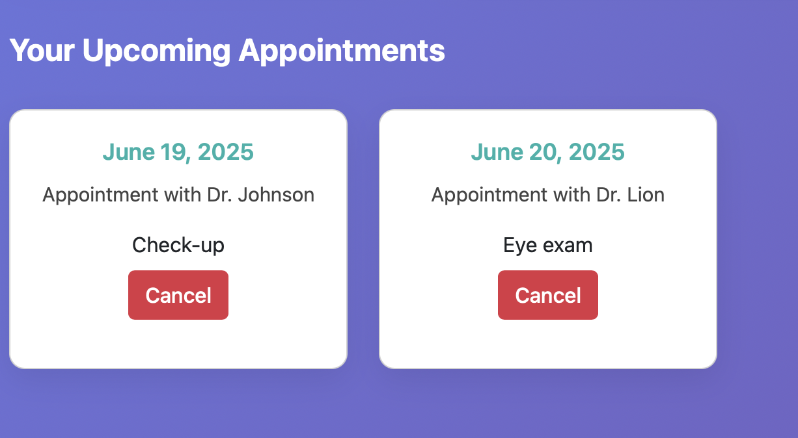
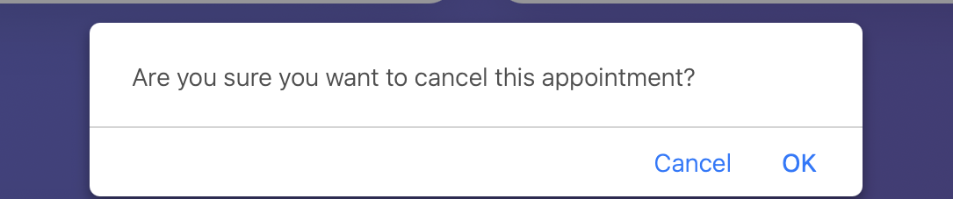
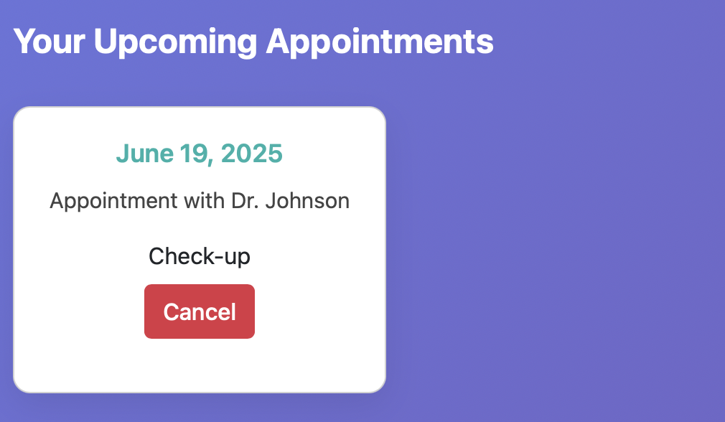

Slide 21
BU METCS 673 Team 3 Project: MyMedic
Iteration 3
Mengliang Tan
QA Lead

Slide 22

Search Function Feature
User Story
Description:
As a patient, I want to search my medical records by doctor or prescription, so that I can quickly find relevant medical history and prescriptions when needed.
Acceptance Tests:
Given I am logged in and I have medical records, when I type the name of a doctor or a prescription and click “Search”, then a list of matched records including doctor, prescription, date, dosage, and notes will appear.
Given I enter a keyword that doesn't match any record, then a message saying “No results found” is shown on the page.

Slide 23
Search Process
Logged-in patients can access a search bar to filter their medical records
A search input field appears at the top of the dashboard labeled "Search Records"
When the user types a keyword (e.g. doctor or prescription name), a request is sent to the backend
If no records match, a message like “No results found” is shown
If matching records exist, they are displayed dynamically below the search bar
Each result shows doctor name, prescription, dosage, date, and notes

Slide 24
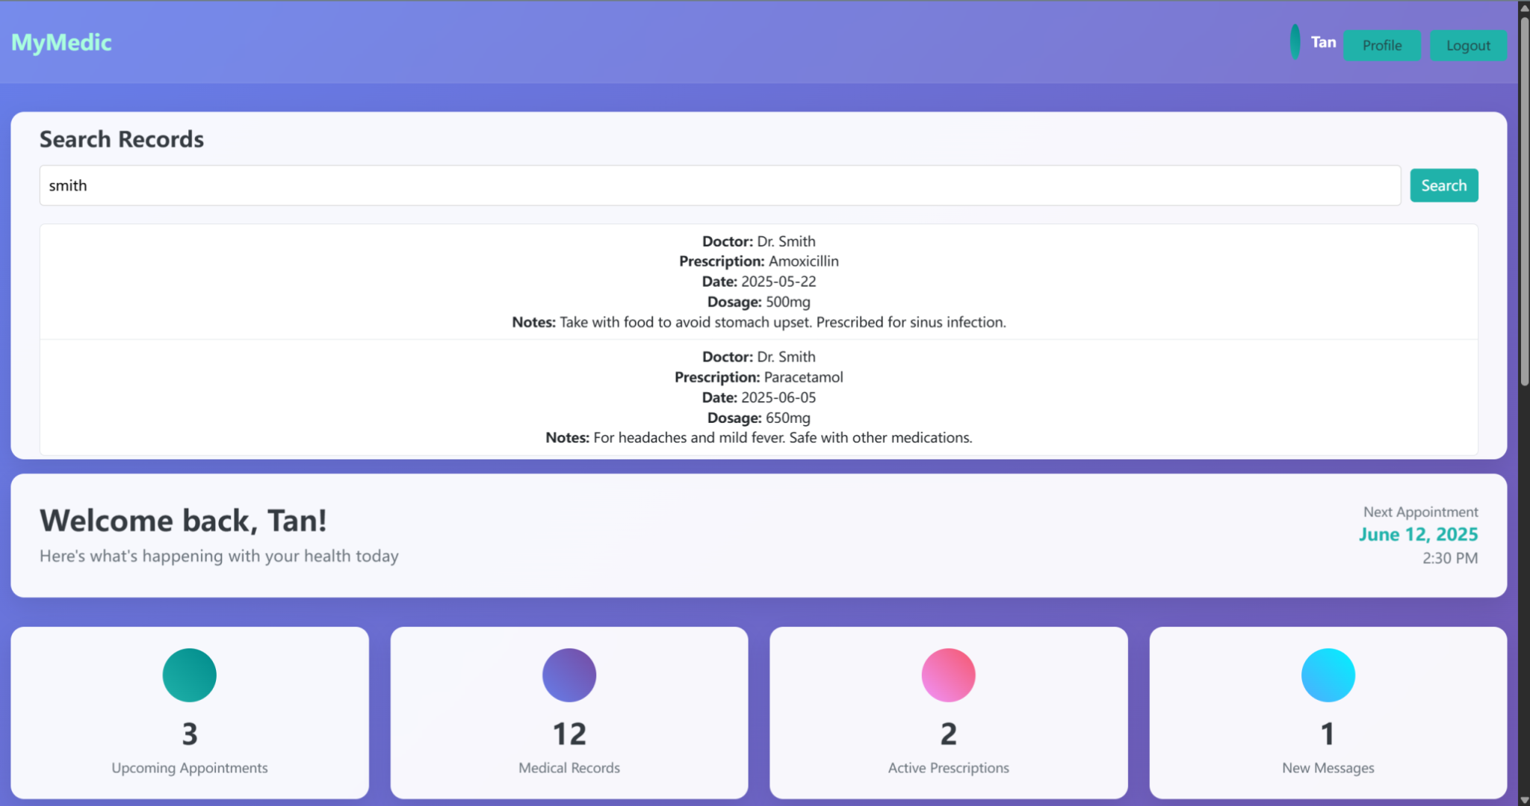
Searched by Doctor’s name

Slide 25
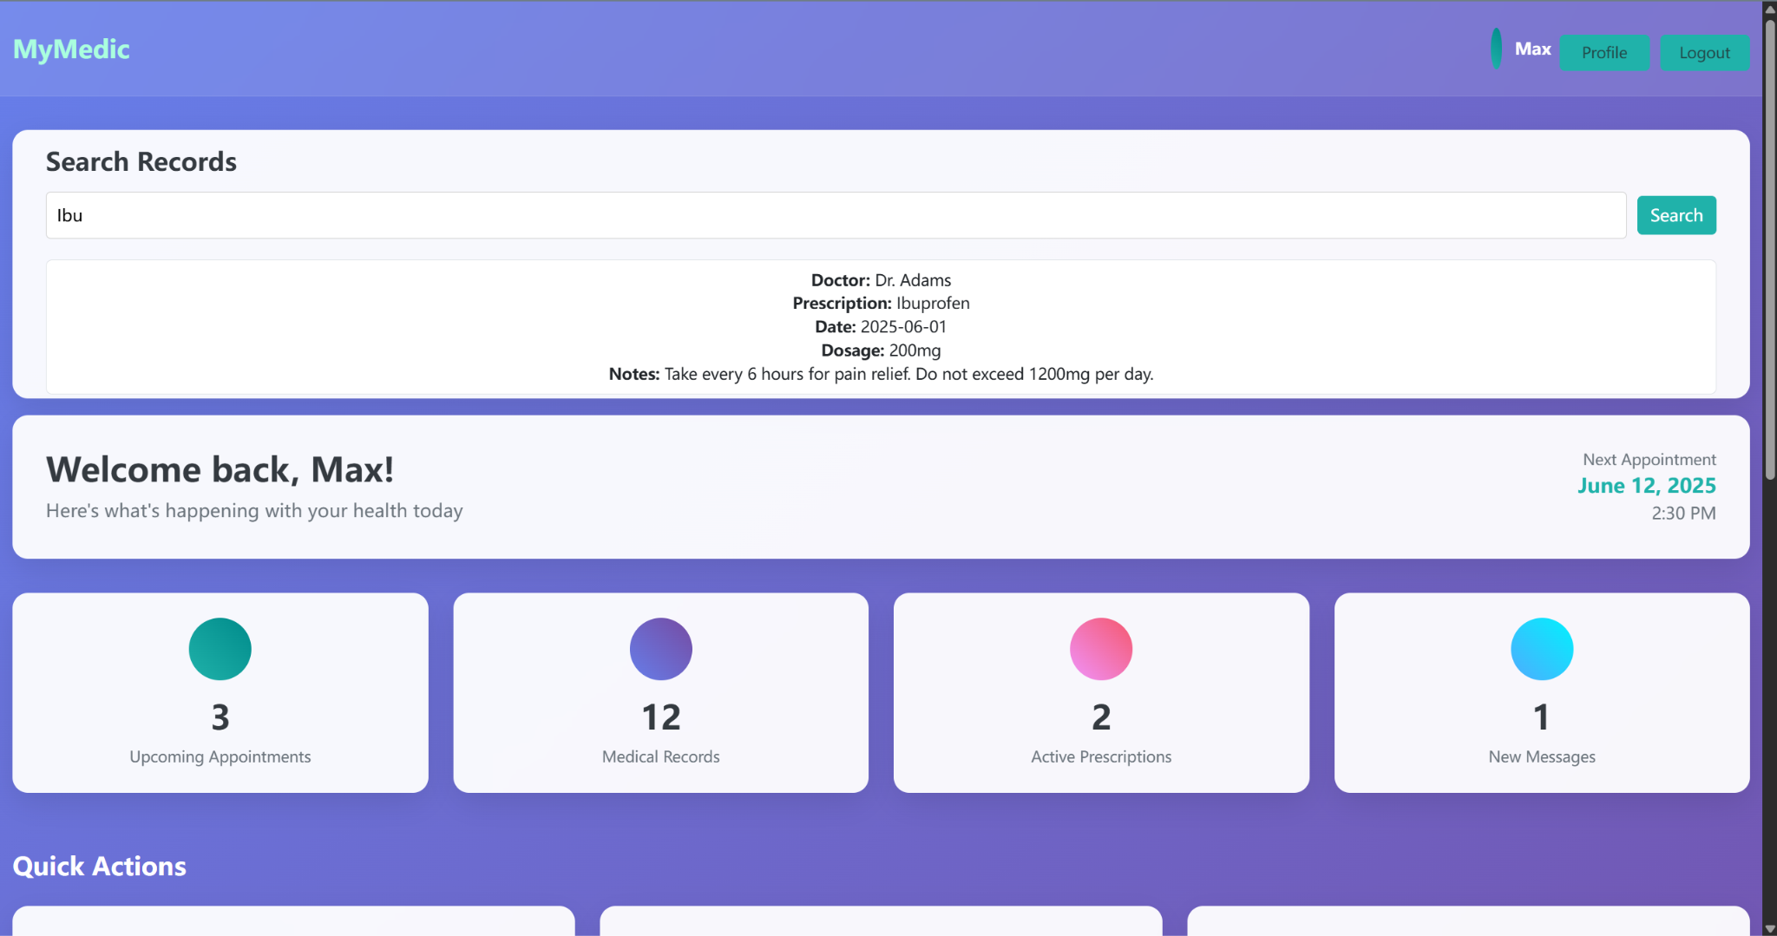
Searched by Prescription name

Slide 26
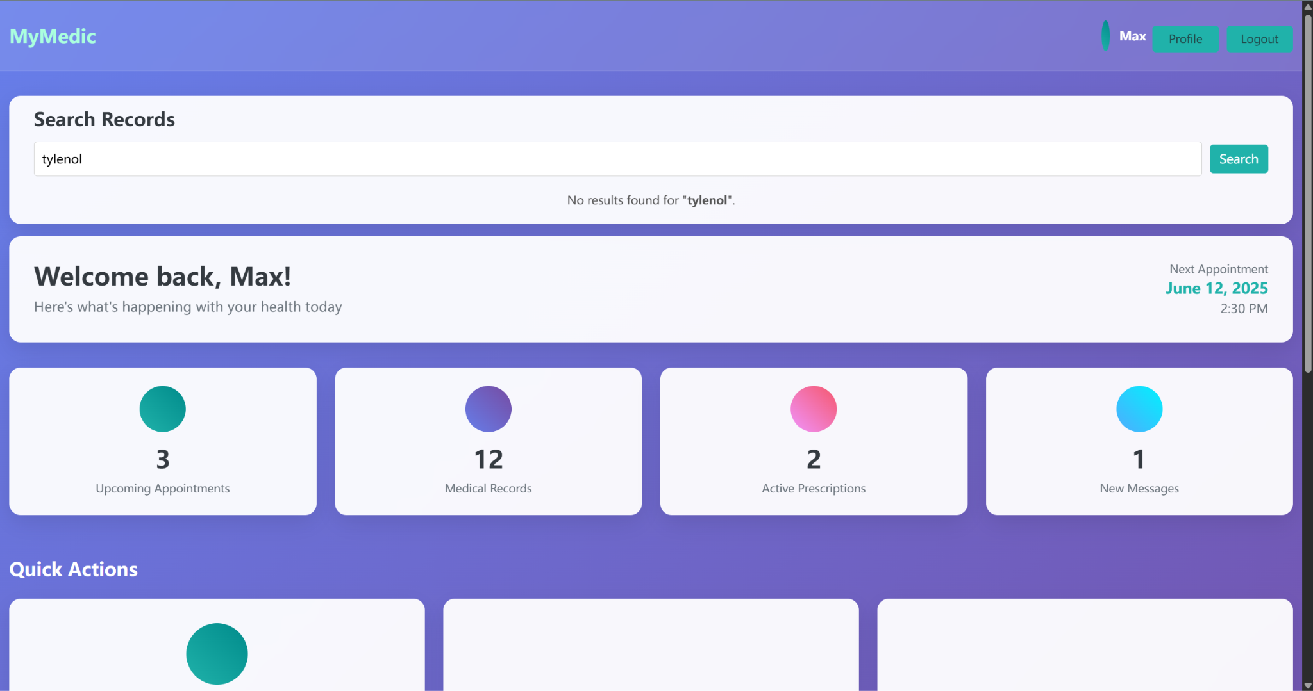
No matching results

Slide 27

BU METCS 673
Team 3 Project: MyMedic
Iteration 3
John Gutierrez

Slide 28
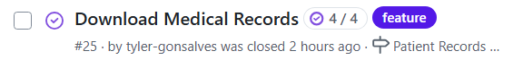
Download Medical Records PDF Feature
User Story
Description:
As a patient, I want to download my complete medical history as a PDF, so that I can share it with a new provider or hospital.
Acceptance Tests:
Given I am logged in and I have medical records stored, and the “Download PDF” button is available, when I click the “Download PDF” button, then a preview page is displayed showing a formatted view of my complete medical history, and a “Confirm & Download” button is visible.
Given I am logged in but have no medical records stored, when I click the “Download PDF” button, then I am shown a message saying “No records available to export” and no preview or download options are shown.

Slide 29
Download Medical Records PDF Feature
Download Medical Records Feature Process Flow:
Logged-in patients can securely access and download their medical records
A "View Records" link in the dashboard redirects users to a protected records page
If no records are available, a message like “No medical records found” is displayed
If records are available, patients can preview and download them as a PDF
The PDF includes patient name and download date for traceability
Access is HIPAA-compliant, protected by authentication and session management

Slide 30
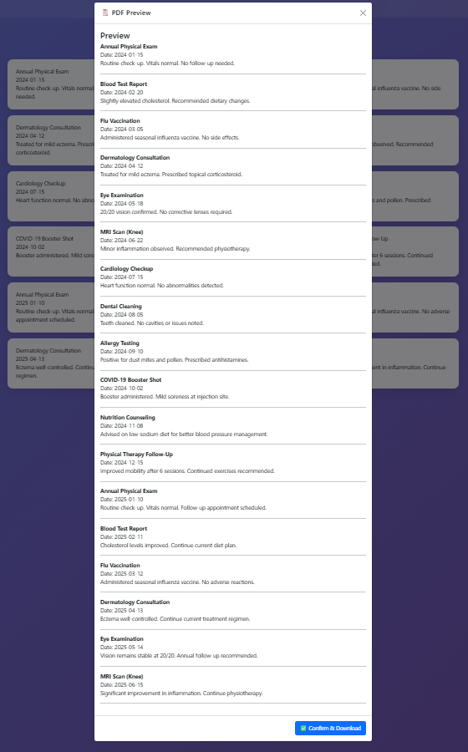
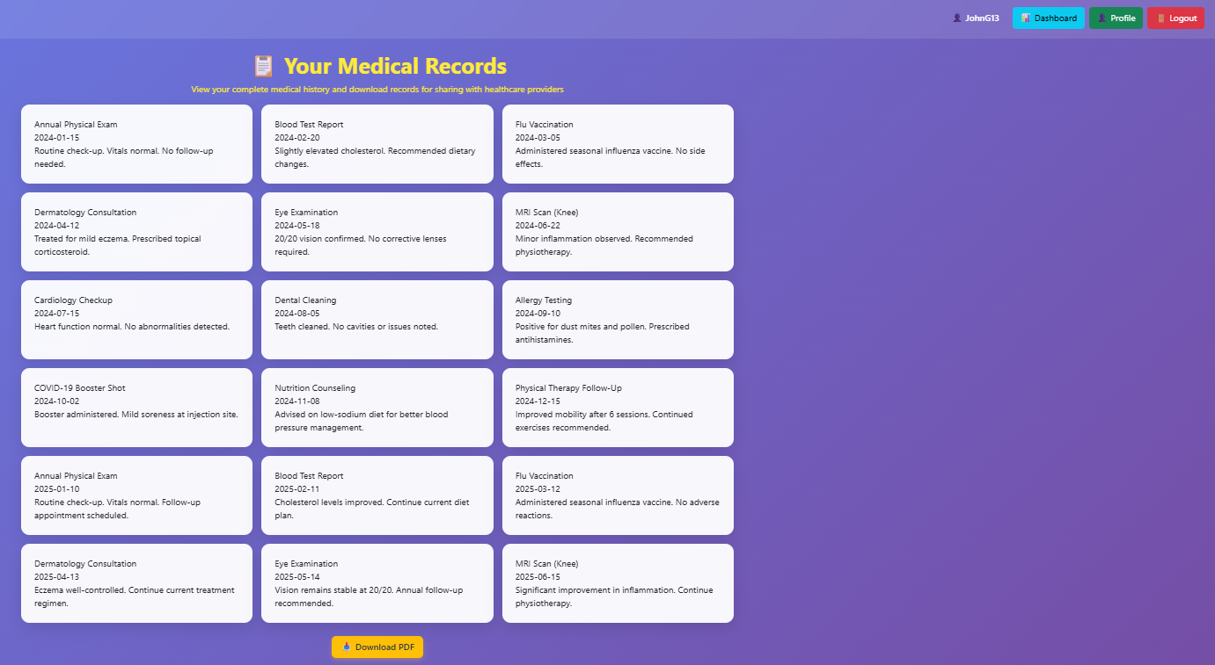
Download Medical Records PDF Feature
Medical Records page view.
Preview PDF, Confirm & Download

Slide 31
Download Medical Records PDF Feature
Testing: Download Medical Records
test_pdf_preview_with_records: Confirms page loads with user records
test_pdf_preview_without_records: Validates graceful handling when no records exist
test_pdf_download_endpoint: Simulates secure PDF download request
test_medical_records_requires_login: Ensures unauthenticated access redirects to login
test_medical_records_authenticated_access: Confirms template rendering for authorized users

Slide 32
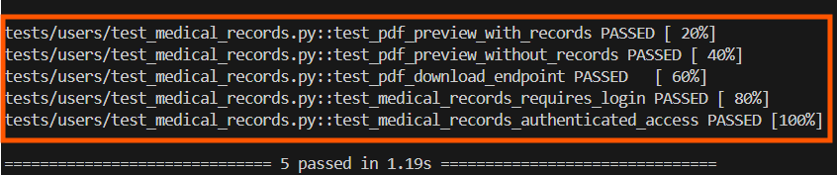
Download Medical Records PDF Feature
Testing: Download Medical Records Results
5/5 tests passed
100% pass rate
Security, authentication, and rendering verified

Slide 33
Iteration 3 - My Medic App
Adriel Domingo
Requirements Lead
Team 3
Topics:
View appointments feature
Future updates
Testing

Slide 34
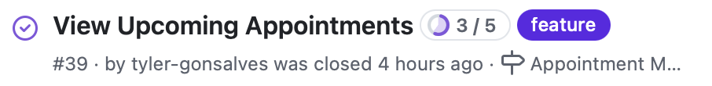
View Appointments Feature
User Story:
Description:
As a patient, I want to view a list of my upcoming appointments so that I can stay informed about my medical schedule.
Acceptance Tests:
Given the user is logged in, when they navigate to “My Appointments”, then all upcoming appointments should be displayed.
Given an appointment was canceled, when the user views their appointments list again, then the canceled appointment should not appear.

Slide 35
View Appointments Feature
Logged in patients can view their upcoming appointments
Clicking on the link will take the user to the “view appointments page
If there are no upcoming appointments, “No appointments scheduled” is displayed
If there are upcoming appointments, they will all be listed in the table

Slide 36
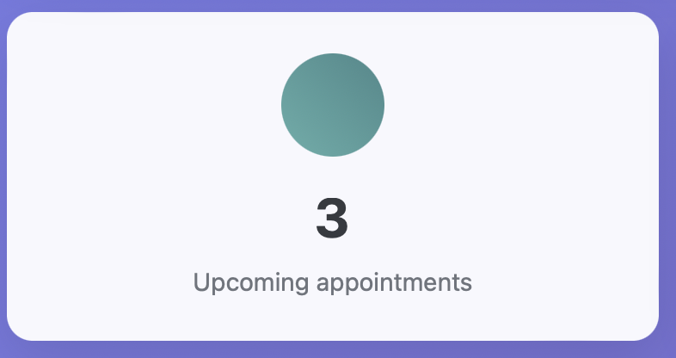
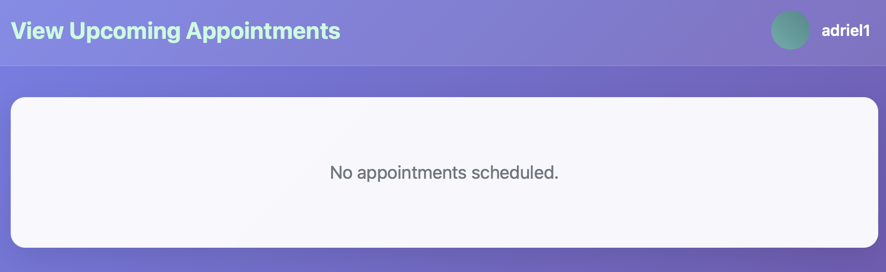
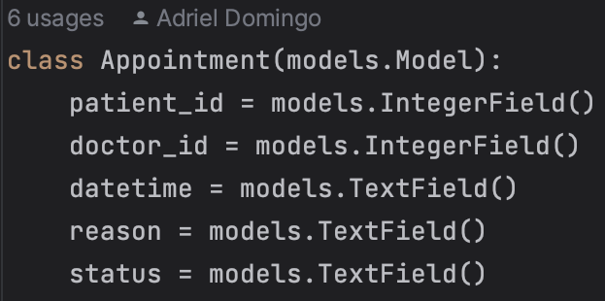
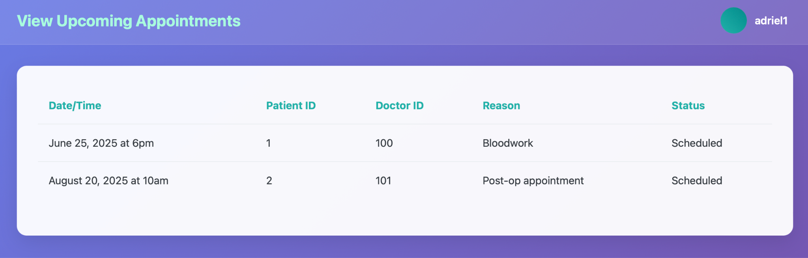
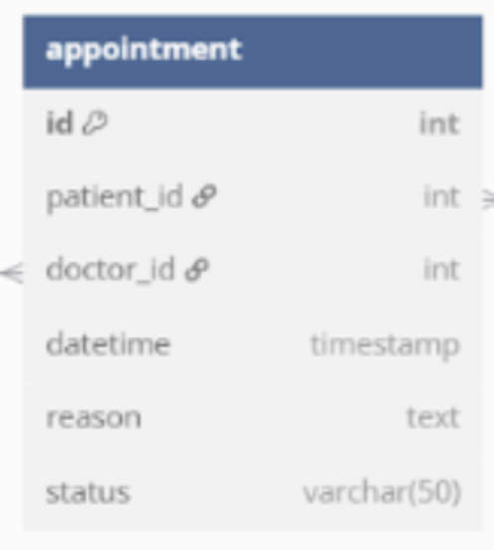
View Appointments Feature

Slide 37
View Appointments - future updates
Work in progress
The number of appointments is hard coded as “3”
Ideally the front end should be able to count the number of upcoming appointments and update the number on the dashboard accordingly
To enhance user-friendliness and readability, the database should convert the Patient ID and Doctor ID values to string names
Doctor view, where they have enhanced permissions for editing the appointment information.

Slide 38
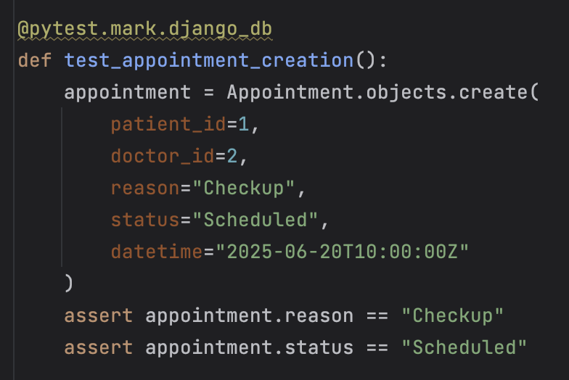
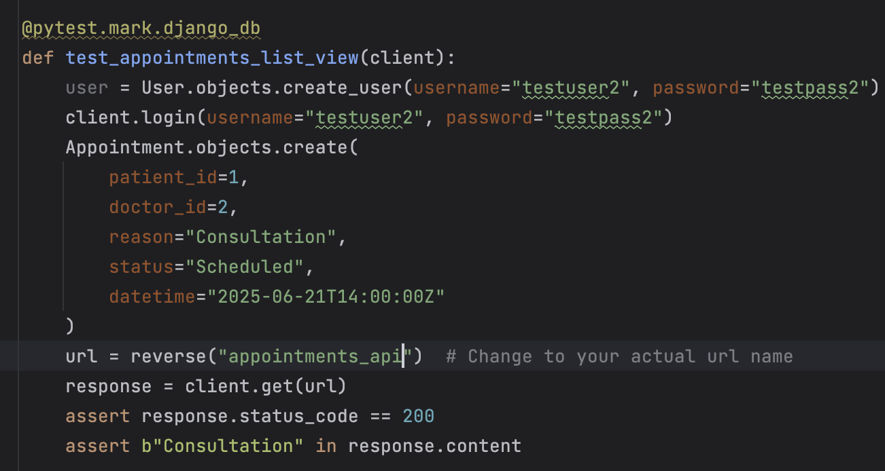

View Appointments - Testing
Running the command docker run --rm -v "$PWD:/appointments" -w /appointments mymedic pytest -v tests/ produces the following output:

